Slide 1
Phase 3: Research with Stakeholders

Slide 2
Research Focus:
Investigating whether emotionally responsive AI (NPCs that react to player emotions in real time) create stronger feelings of immersion, empathy, and presence compared to non-responsive NPCs.
Link to Github with all information/ notes/ code https://github.com/Kstuteville/Emotion-NPC-Prototype/blob/main/README.md

Slide 3






Identifying Stakeholders
Players/ Gamers
Measure emotional impact and comfort levels of emotion-aware AI
Academic Advisors
Ensure rigour and advise on affective computing ethics
Peer/Collaborators
Provide UX and emotional design feedback
Researchers
Narrative Stakeholders
Evaluate whether emotion-driven responses fit character tone
Ethics-Minded Participants
Surface fears, trust issues, and ethical implications

Slide 4
Research Question + Hypothesis
RQ: Does an emotionally responsive AI NPC make players feel more connected, immersed, and emotionally understood than a neutral, non-responsive one?
Hypothesis: Players will report higher emotional engagement and presence when NPCs show adaptive empathy or mood mirroring.

Slide 5
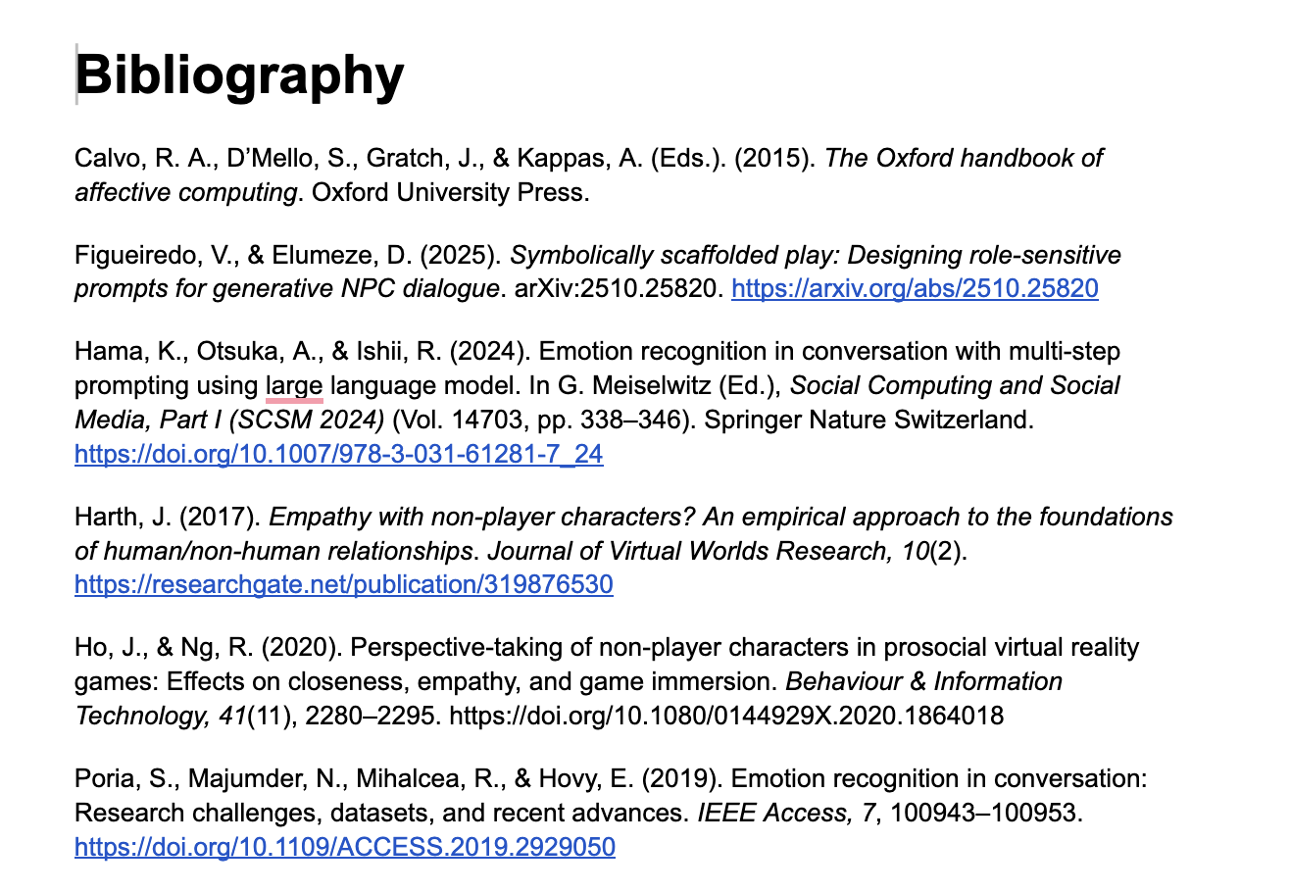
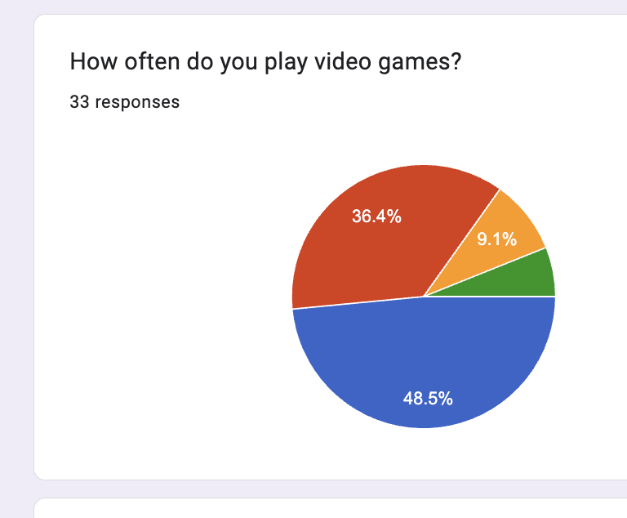
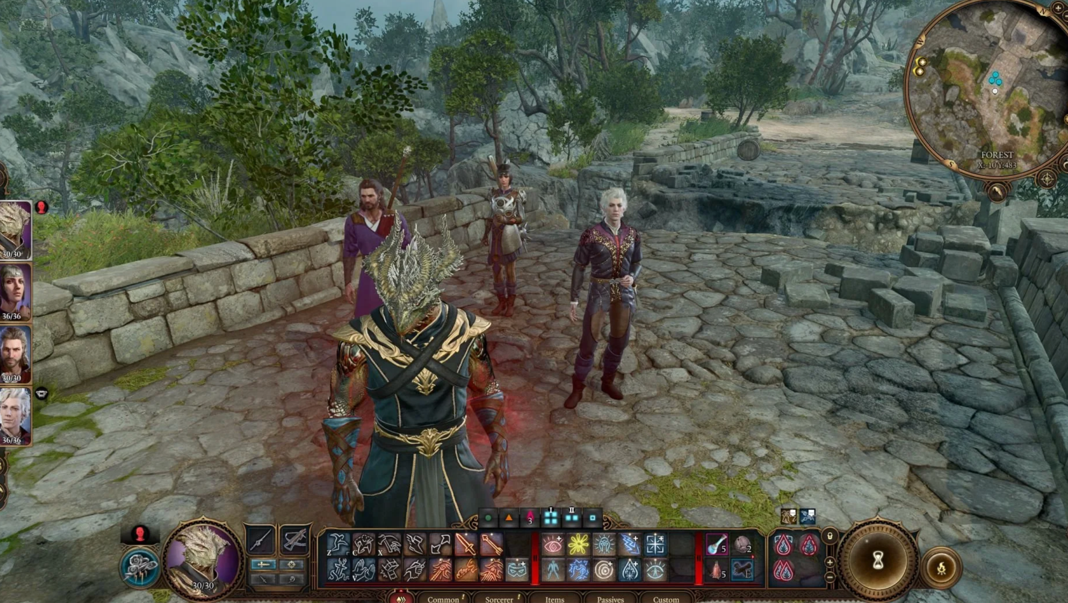
Academic Literature Review
Overview of Methods
(and links to the notes)
Player Pre Survey (google form)
Observation Playthrough study
https://docs.google.com/document/d/1gb5iewcSD-IBlK4pZFEh0Ck1iWSjtq4nmw8dzyOMNxc/edit?tab=t.0#heading=h.zcl1tk3htmil
To ground my prototype in existing theory and identify research gaps.
Finds a baseline towards players attitude towards Npcs in games. Measure broad attitudes toward emotionally responsive AI; gauge comfort, curiosity, and trust
https://docs.google.com/document/d/1aC1gnfLmV-rVHHeTLQ0Rkk2ZaCawcz-V1Vk35924LtA/edit?usp=sharing
https://docs.google.com/forms/d/1b9kZnlHlpsBSOXF65w3nEB_w9ybH_HMNjy4xWWOr4V8/edit
Using referenced games in Academic Literature and results from survey, I gather and Observe how real players emotionally engage with NPCs across different games (emotion-aware vs neutral)

Slide 6
Academic Lit Review
All notes accessible on Github: https://github.com/Kstuteville/Emotion-NPC-Prototype
Key Texts Read:
1. The Oxford Handbook of Affective Computing (Calvo et al., 2015)
2. Emotion Recognition in Conversation (Poria et al., 2019)
3. Emotion Recognition in Conversation with Multi-Step Prompting Using LLMs (Hama et al., 2024)
Main Ideas Across All Texts
Emotion is contextual and dynamic. Effective systems must track changes over time, not just single snapshots.
Multimodal cues improve accuracy. Facial expression alone is limited; gameplay behavior, voice tone, and context help resolve ambiguity.
The affective loop matters. Sensing → interpreting → responding → user reaction forms a continuous cycle that shapes experience.
Misrecognition is inevitable. Systems need strategies for ambiguity, sarcasm, and masked expressions.
Reasoning layers add depth. LLM-based interpretation can connect emotion to cause, narrative context, and player history.
Evaluation must be both technical and experiential. Accuracy, latency, presence, empathy, and “aliveness” all need measurement.
Narrative grounding strengthens believability. Emotion-aware behaviors must fit the world and character logic.

Slide 7
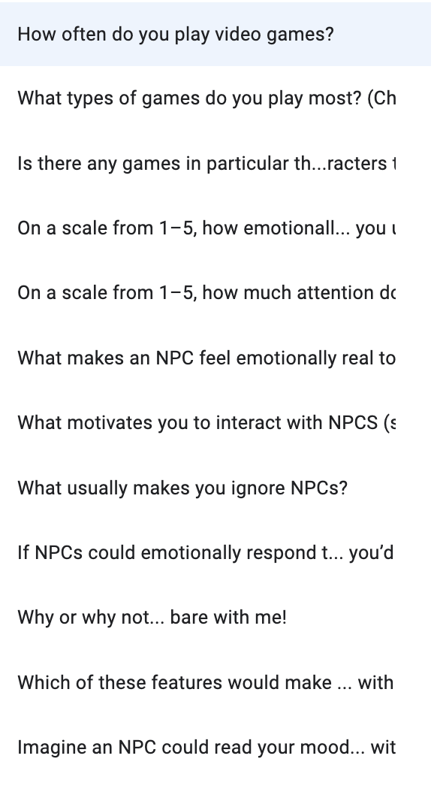
Player Survey
Goal: Capture attitudes, beliefs and expectations about NPCs in games.
Sampled 30+ people, targeting specifically people with gaming experience, game designers, and academics
Link to form : https://docs.google.com/forms/d/1b9kZnlHlpsBSOXF65w3nEB_w9ybH_HMNjy4xWWOr4V8/edit#question=2020787386&field=492904719

Slide 8
Overall answers
Across 30+ responses, players consistently describe emotionally responsive NPCs as more immersive, more meaningful, and more alive— but only when done in a way that supports player agency and doesn’t break roleplay.

Slide 9
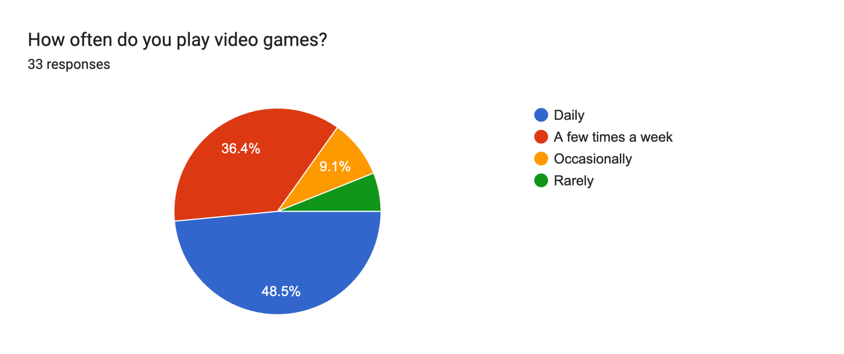
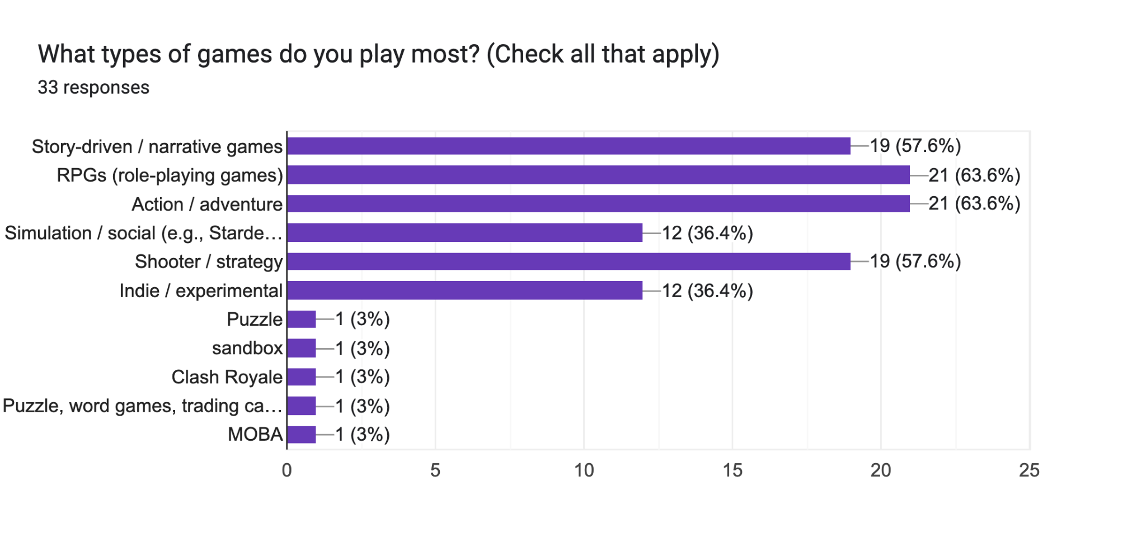
Results of Form

Slide 10
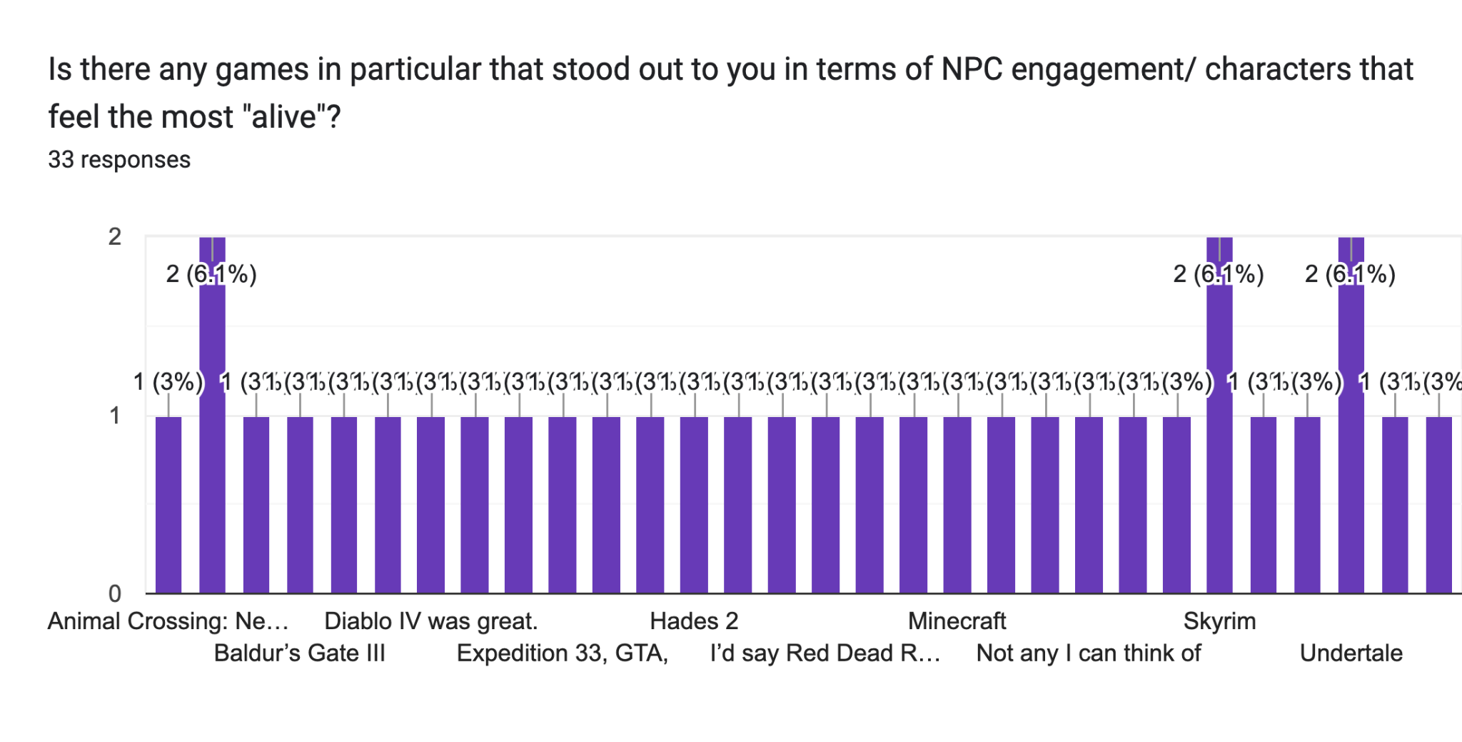
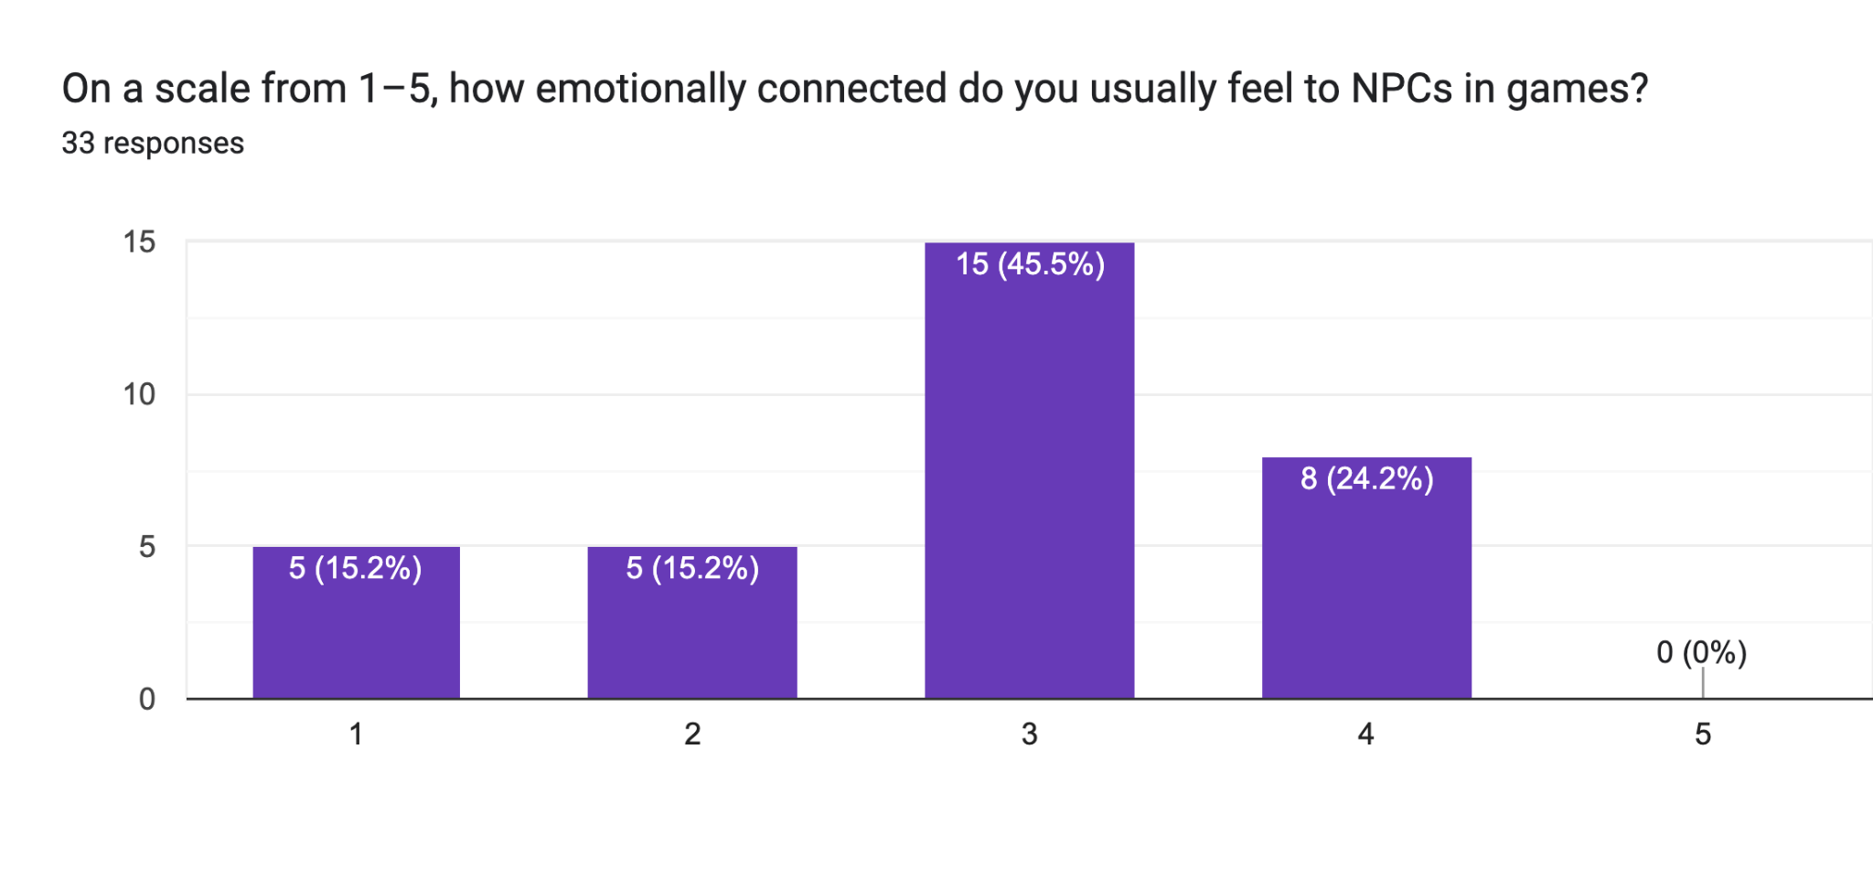

Slide 11
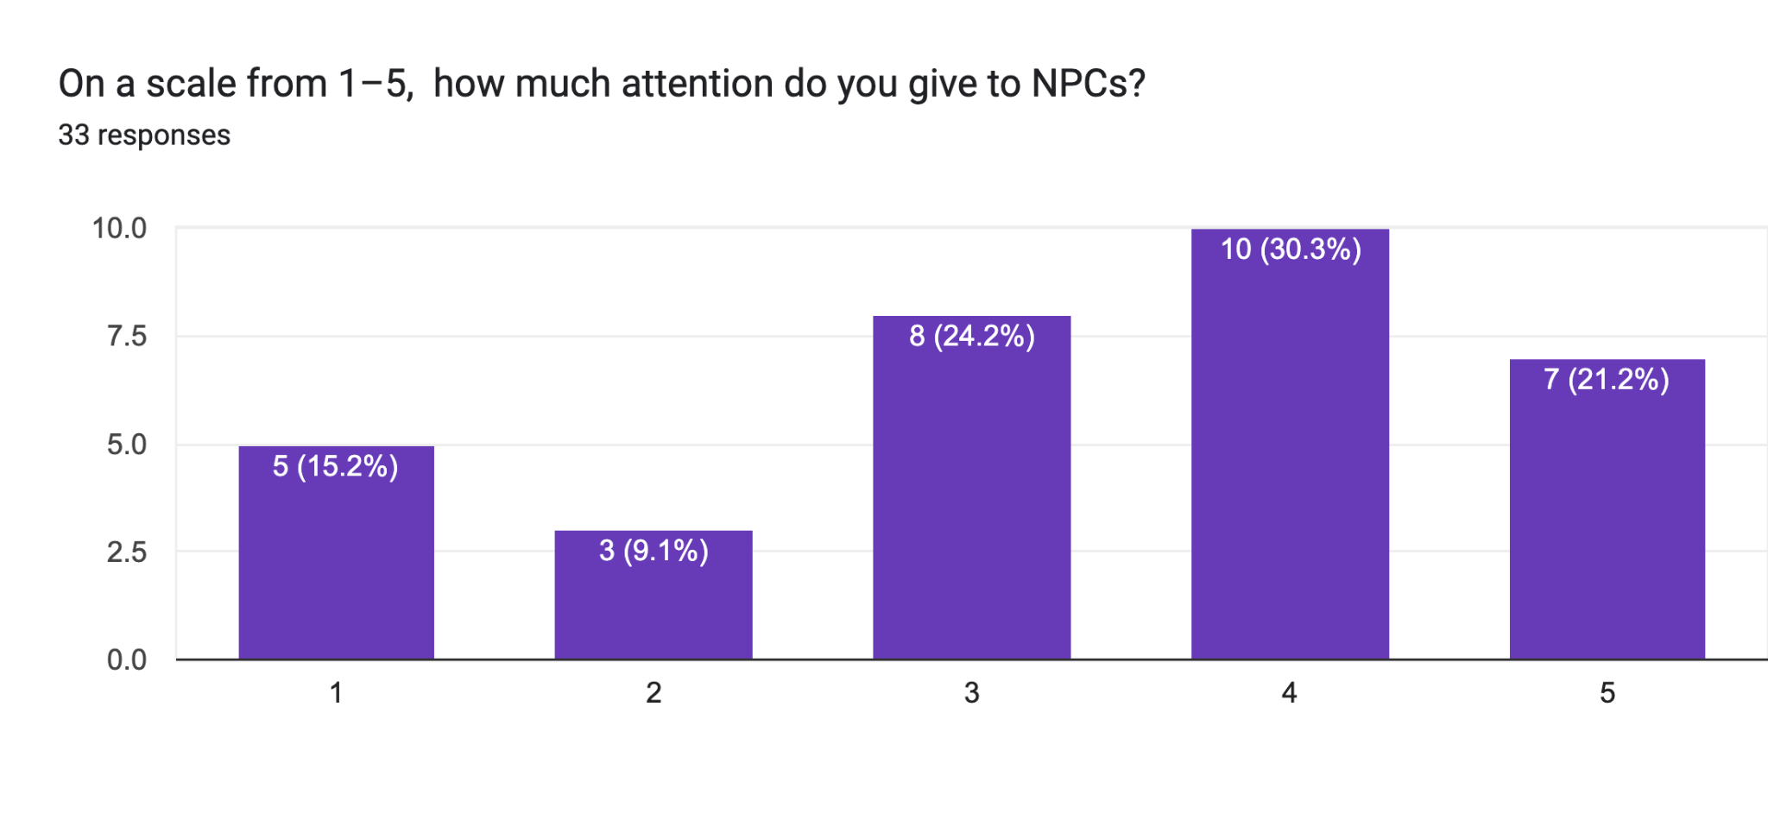
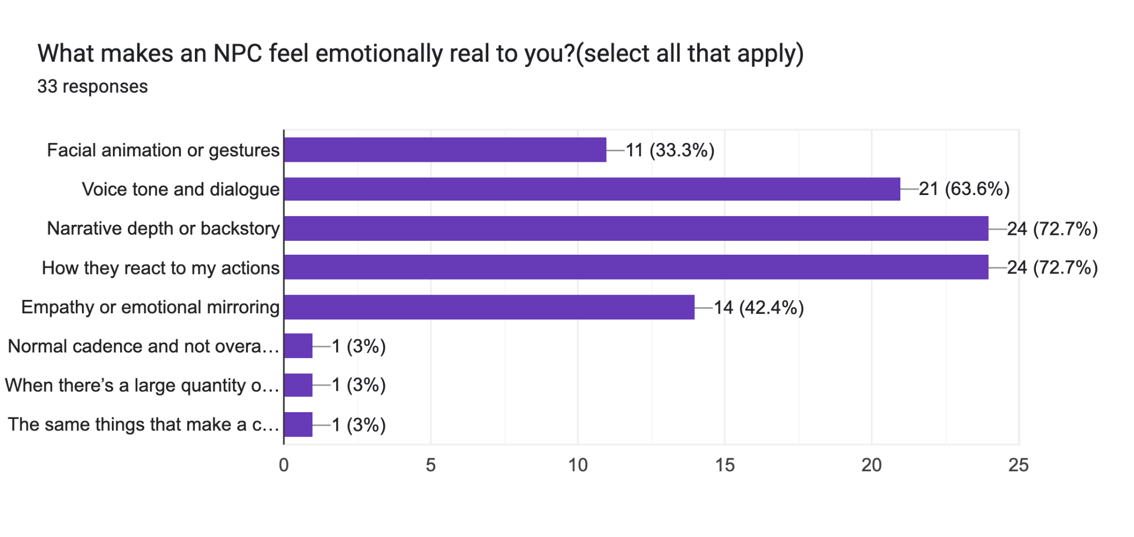

Slide 12
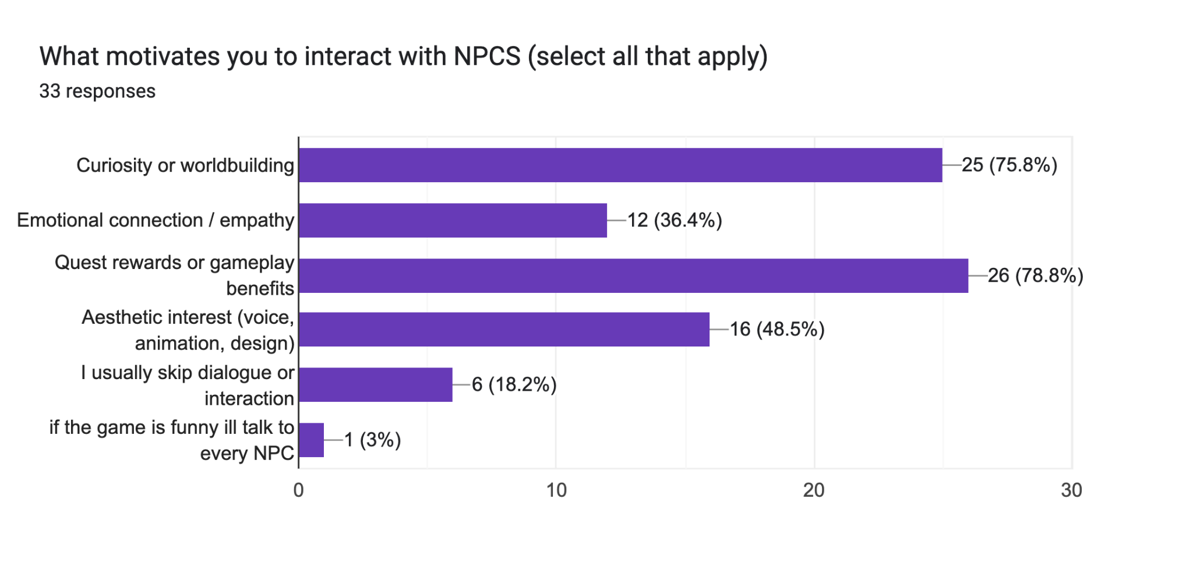
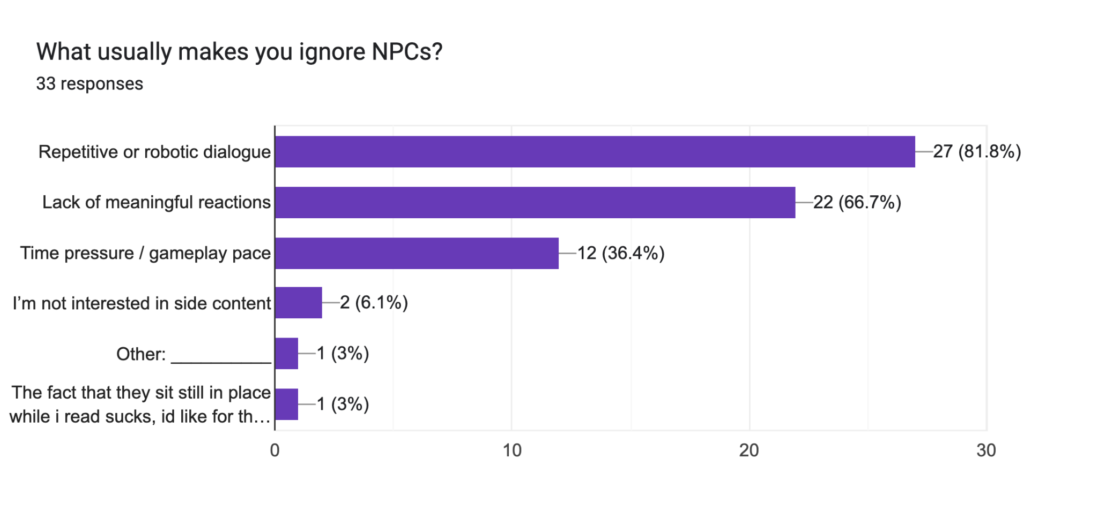

Slide 13
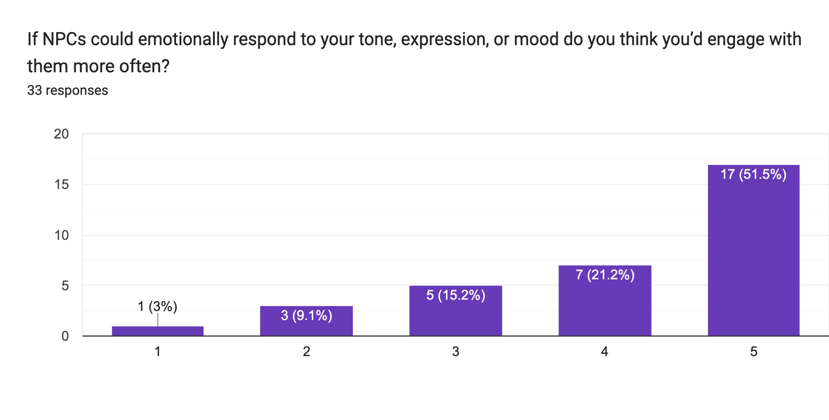
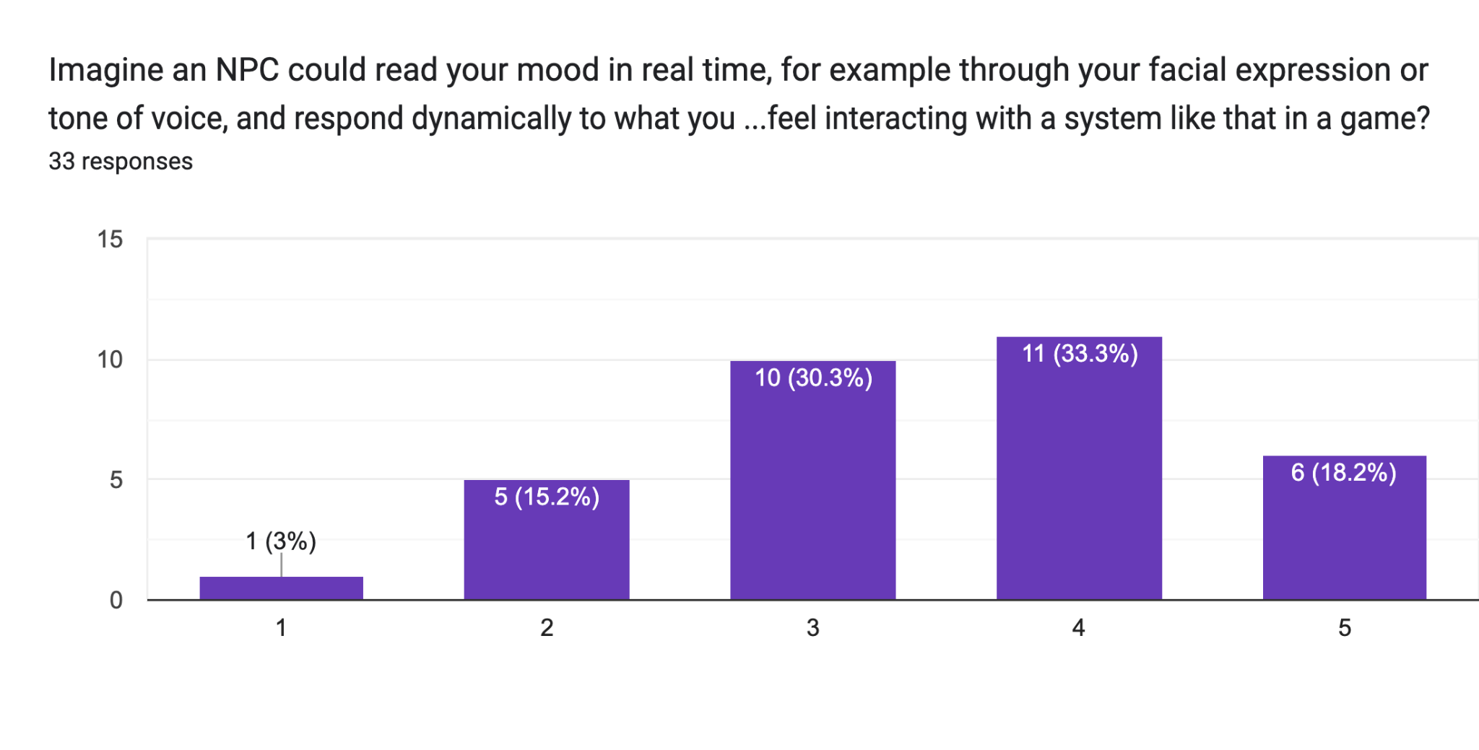

Slide 14
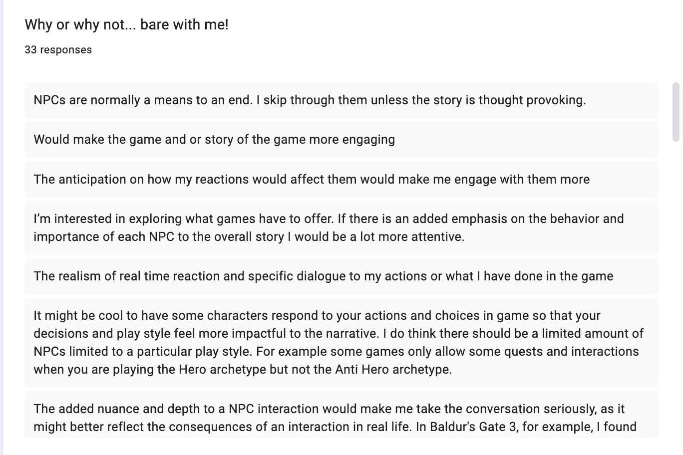
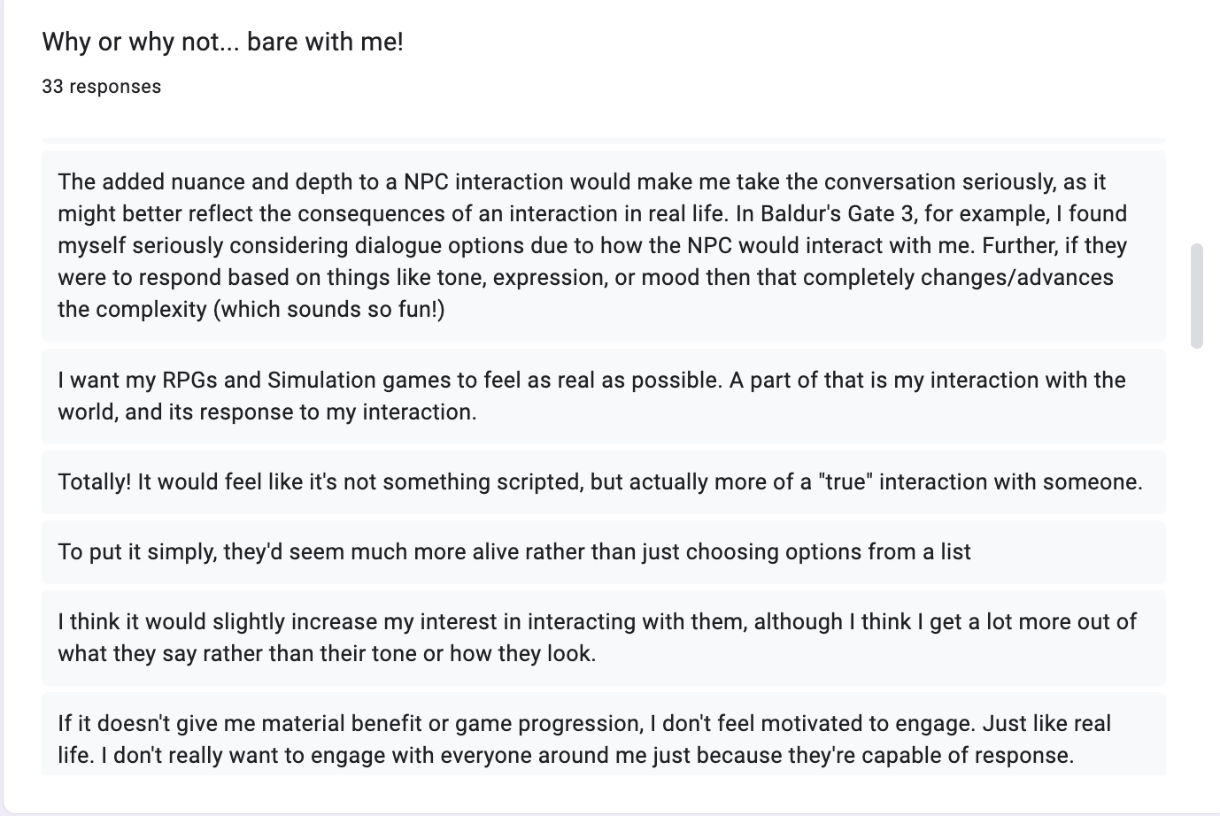
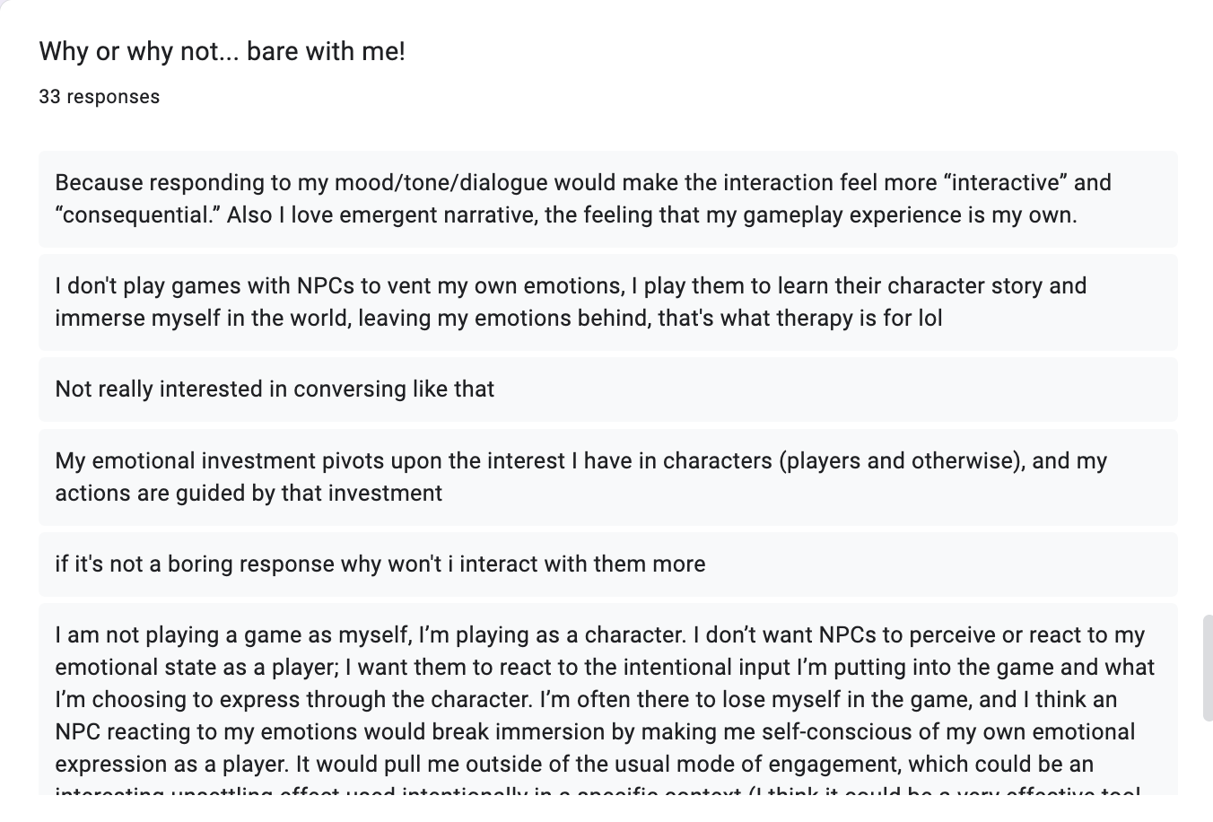
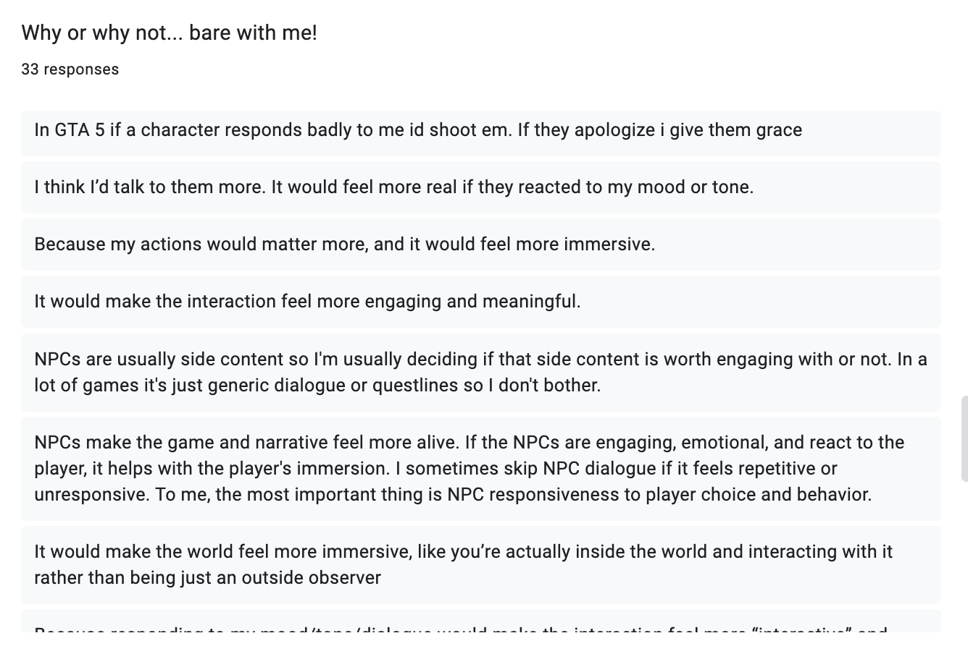

Slide 15
What Players Are Saying (Condensed Themes)
1.Increase immersion & realism
2. Depth, nuance, and emergent storytelling
3. Engagement depends on appropriate response quality
4. Player agency & roleplay boundaries matter
Most players say emotion-aware NPCs would
make the world feel more reactive and alive
feel less scripted and more like real conversations
increase emotional investment in the story
make choices feel more meaningful
This is the biggest and clearest theme.
Players expect:
more nuanced interactions
Dynamic responses tied to tone, mood, expression
the feeling of emergent narrative rather than prewritten dialogue
Many mention Baldur’s Gate 3 as a reference point, wanting even richer responsiveness.
Players would engage more if:
Responses are tailored, not generic
Reactions make sense in context
The NPC’s behavior changes in believable ways
Poor or mismatched reactions kill immersion.
A significant minority raise concerns:
Some play as characters, not as themselves; their real emotion shouldn’t override character intent
Some worry it could break immersion by making them self-conscious.
Some don’t express emotion when gaming; worry the system won’t “read” them.
Some only care if it affects gameplay or progression.
Conclusion: Emotion recognition must supplement, not overwrite, intentional roleplay choices.
Players want an NPC that responds to their emotional cues in subtle, context-aware ways that enrich immersion and story depth—without forcing personal emotions into the game or making interactions feel awkward or mismatched.

Slide 16
Observational Study:
https://docs.google.com/document/d/1aC1gnfLmV-rVHHeTLQ0Rkk2ZaCawcz-V1Vk35924LtA/edit?usp=sharing
This observational study examined emotionally responsive NPC systems across a range of game designs, from narrative-heavy titles like Baldur’s Gate 3, Red Dead Redemption 2, and Undertale to systemic AI-driven experiences such as Skyrim and the interactive drama Façade. In these games, emotional engagement emerges from a combination of worldbuilding, facial animation, long-term character arcs, ambient behavior, and systemic AI. NPCs feel emotionally present not because of one isolated mechanic, but because multiple systems—story, environment, animation, and memory—work together to create a holistic sense of social presence.
In contrast, this project focuses on a modular prototype rather than a full game. The goal is to isolate and test a single component of NPC design: the moment-to-moment emotional interaction loop powered by facial emotion recognition, vocal tone analysis, and adaptive dialogue. Instead of building an entire narrative ecosystem, the prototype functions as a transferable behavior module that could be inserted into different games or engines. Observing commercial games provides a comparative foundation for this work, highlighting how players currently connect with NPCs and helping define the design principles needed for a standalone emotionally responsive NPC system.

Slide 17
Key Findings: Moment-to-Moment Emotional NPC Interactions
1.
2.
Instant emotional cues (facial reactions, tone shifts, warnings, flinches)
Short-term emotional memory that shaped the next reaction
Across the analyzed games, emotionally engaging NPC behavior consistently emerged from immediate, real-time feedback loops. NPCs responded to player actions through micro-expressions, vocal cues, body language, proximity shifts, or rapid changes in behavior
Four patterns appeared across all titles:
3.
4.
Adaptive behavior that responded to stress, proximity, or player choices.
Clear nonverbal communication, especially gaze, posture, and pacing.

Slide 18
Thank you

